Slide 1
Fair MOT LITERATURE REVIEW
MULTIPLAYER TRACKING CVPR
PROJECT 1
Aditya Bothra
Tyler Banks

Slide 2
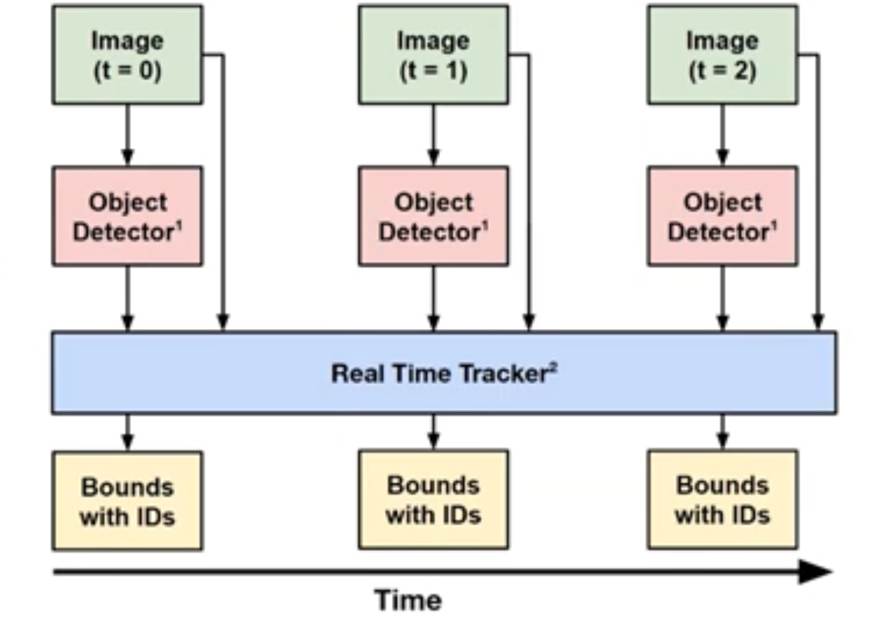
Tradition Method of Multiplayer Tracking:
Can use a detector like YOLO or faster R-CNN
Most popular method is DeepSORT, which uses Kalman Filter for assigning ID’s , and deep learning appearance measurements and motion tracking for similarity extraction
ISSUES:
Not anchor-free
Low Accuracy
No Re Identification

Slide 3
Centre Track(Tracking Objects as Points)
Instead of predicting anchor boxes separately, it does it with allocating it an ID in a single pass.
It predicts three features with 1 Neural Network in single pass.
Object Centre- Predicts the centre of the object detcted
Object size – Predicts the size to form the boundary of objects
Offset- Uses previous frame information to relate the distance between the object in two consecutive frames.
Uses Greedy Algorithm to match bounds with ID’s

Slide 4
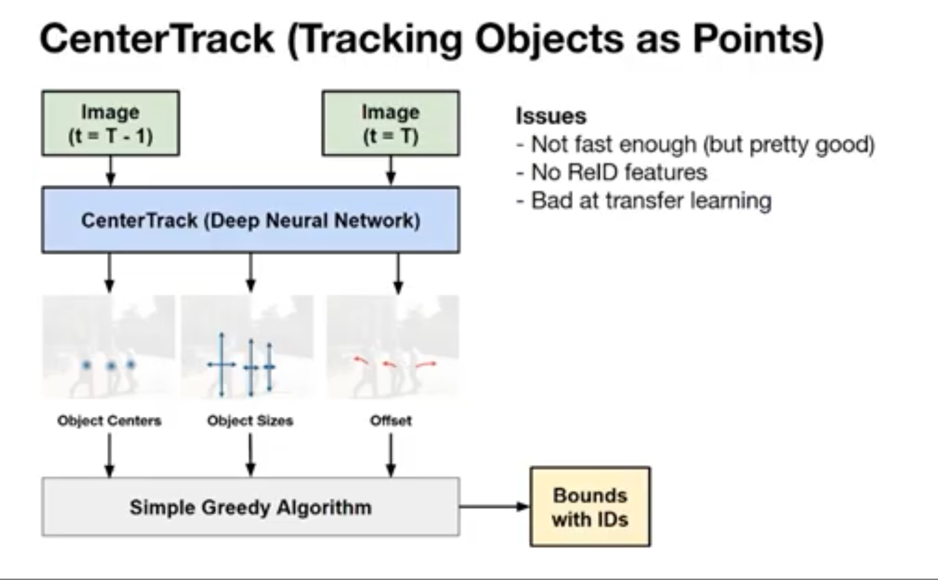
Issues:
Speed (lot many features a bit slower). Greedy algo requires going through all possible features and pixels every time
No Re ID features as if the object disappears it can’t be used at all.
Bad at Transfer Learning (Offset is complicated )

Slide 5
Fair MOT Architecture
Detection
Heat Map | Box Size | Center Offset
Image
Encoder-Decoder
Reidentification
Re-ID embeddings | Extract features | Anchor Box Bounding with Id

Slide 6
PROS: FairMOT
Anchor free
State of the Art Accuracy
Integrated ReId
Transfers well

Slide 7
Deep Sort LITERATURE REVIEW
MULTIPLAYER TRACKING CVPR
PROJECT 1
Aditya Bothra
Tyler Banks

Slide 8
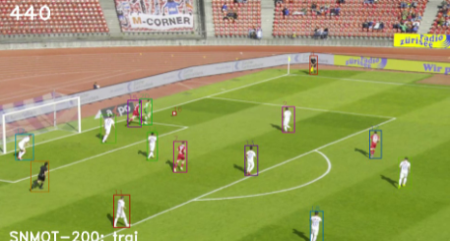
Deep Sort
Compute bounding boxes using YOLO v3 (detections)
Use Sort (Kalman filter)and ReID (identification model) to link bounding boxes and tracks
If no link can be made, a new ID is assigned and it is newly added to tracks

Slide 9
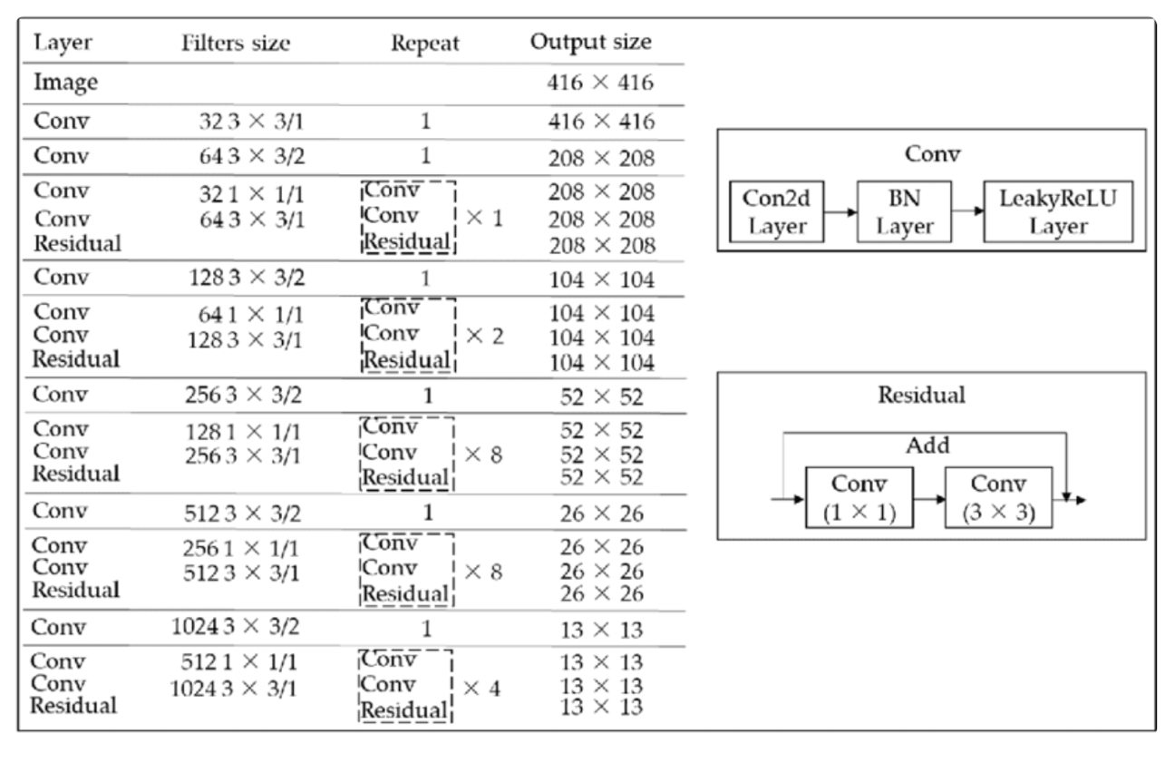
Architecture Yolov3

Slide 10
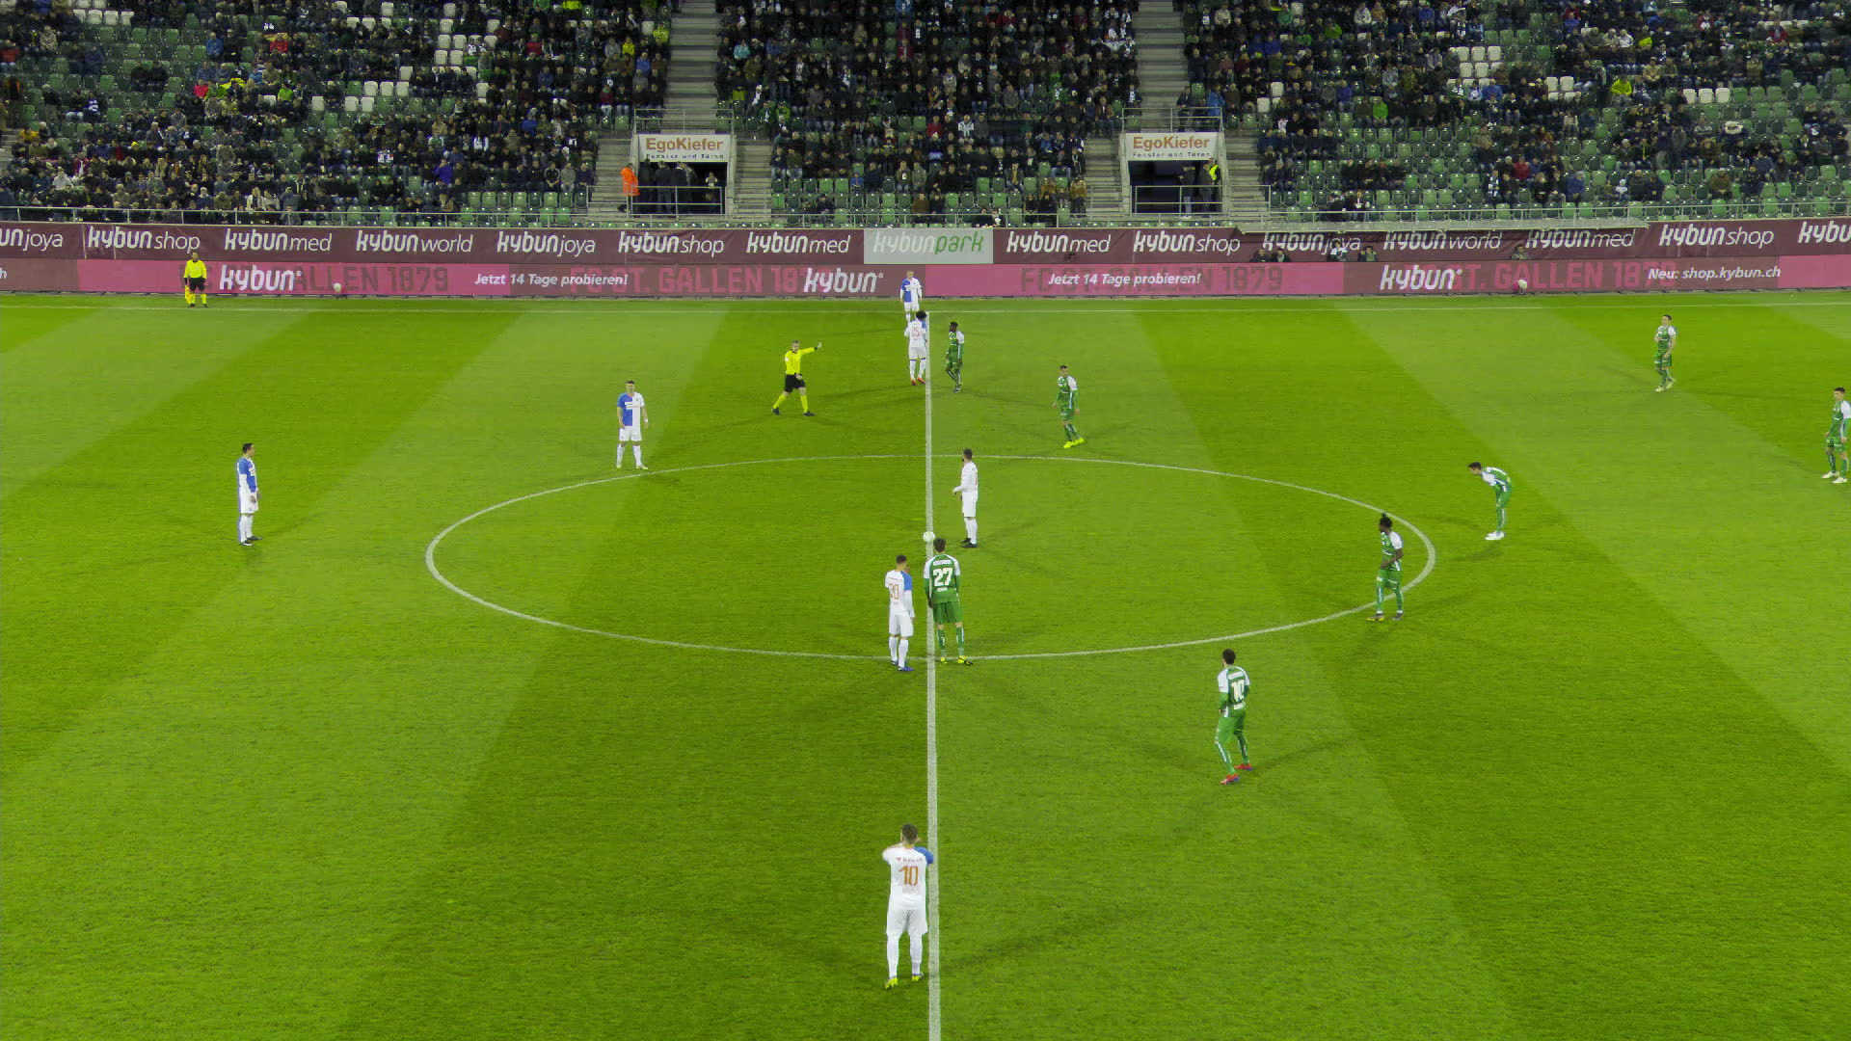
Architecture Yolov3
The Tracking dataset consists of 12 complete soccer games from the main camera including:
200 clips of 30 seconds with tracking data.
one complete halftime annotated with tracking data.
the complete videos for the 12 games.

Slide 11
THANK YOU

